Slide 1


RESOURCE
Correct Referencing Guidelines
This template is to be used in a flexible way to suit the needs of the presentation. You can add images, colour and graphic elements as needed.

Slide 2
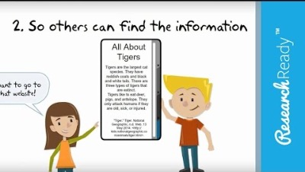
Citation for Beginners
https://www.youtube.com/watch?v=CDGdqoCyAtw
Virtu Design Institute Pty Ltd (RTO 40530 - ABN 31 154 273 757) trading as APC Design School
Young Rabbit Pty Ltd (ABN 28 003 381 182) trading as Australian Pacific College | RTO Code: 90396 | CRICOS Provider Code: 01331F

Slide 3
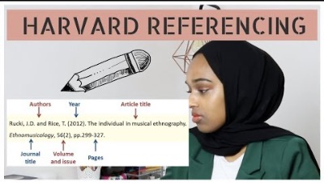
HOW TO HARVARD REFERENCE RESEARCH ARTICLES IN 1 MINUTE
https://www.youtube.com/watch?v=AVeRlhG9gB8

